Slide 1
Basic presentation

Slide 2
Project objective
The specific objectives of this project are to:
Collect and preprocess a dataset of historical patient data.
Develop a machine learning model that can predict the survival of cancer patients.
Evaluate the performance of the model on a held-out dataset.
Deploy the model in a production environment.

Slide 3
Evaluation criteria
Metrics used are
Accuracy
Recall / True positive rate
AUC Score >0.5
MAE / MSE / RMSE
R²
F1 Score

Slide 4
Final impact of implementation
High Recall and Accuracy are needed as this data belongs to cancer survival rate after surgery.

Slide 5
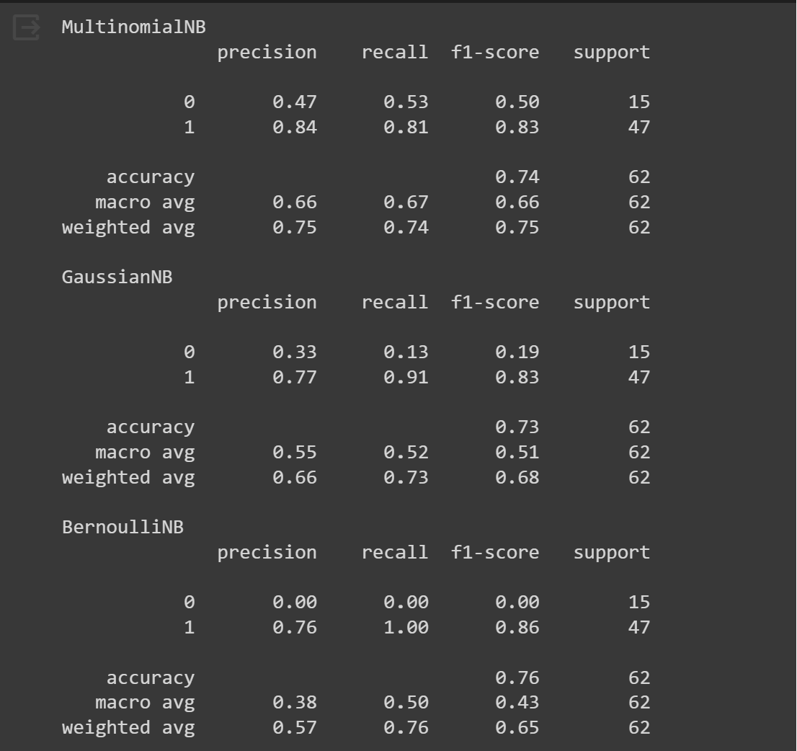
Performance metrics

Slide 6
Evaluation criteria contd….
Naive Bayes classifiers | Accuracy | Recall | AUC Score
Multinomial | 0.74 | 0.81 | 0.67
Gaussian | 0.73 | 0.91 | 0.52
Bernoulli | 0.76 | 1.00 | 0.50

Slide 7
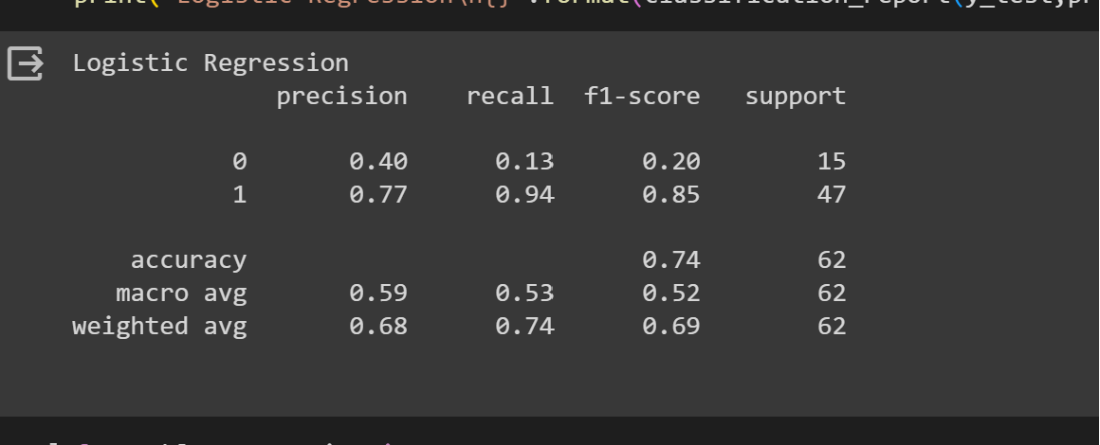
Logistic regression
Logistic regression | Accuracy
Accuracy | 0.74
Recall | 0.94
AUC Score | 0.53

Slide 8
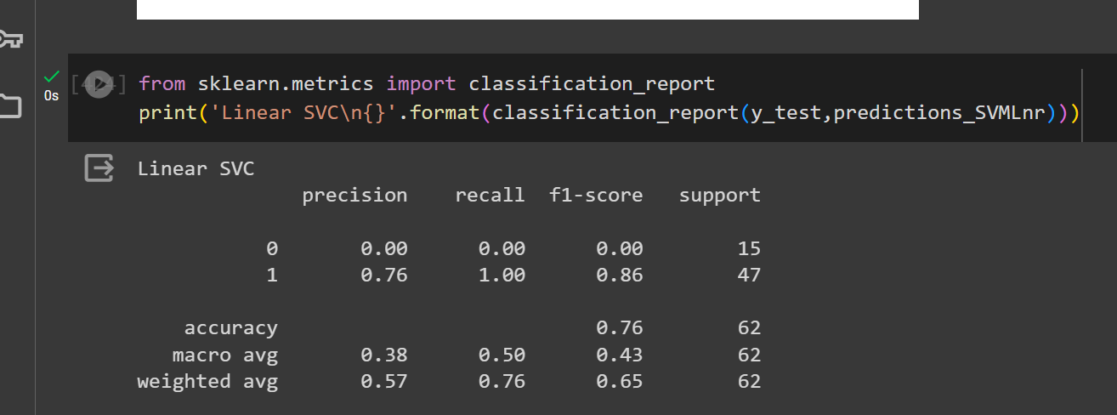
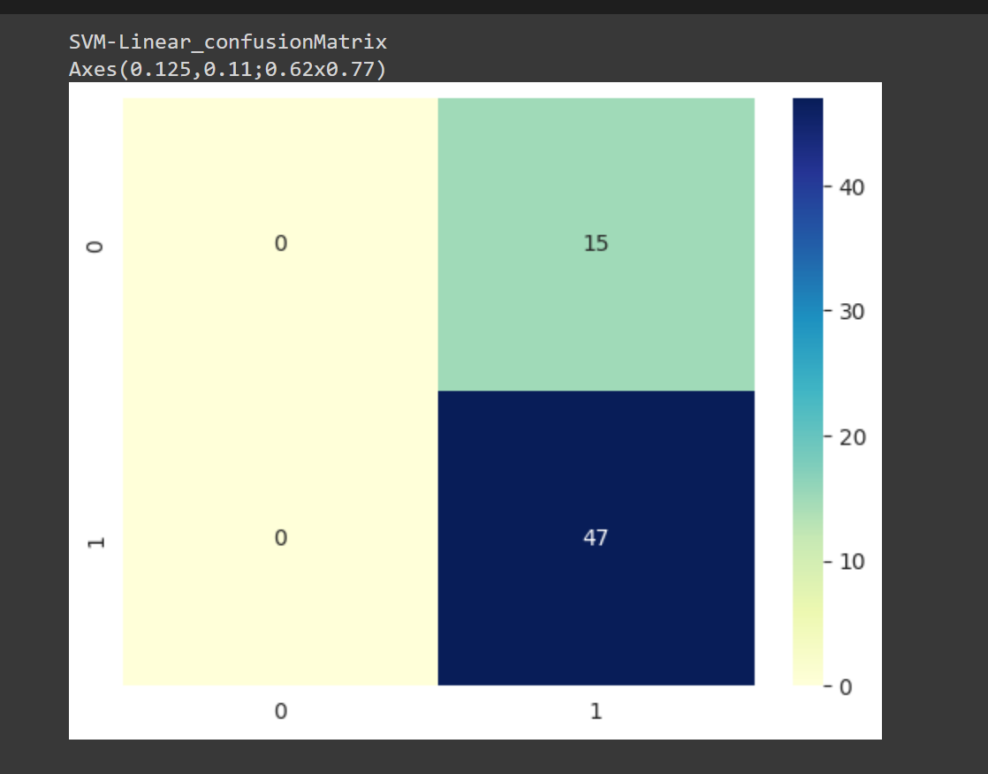
Support Vector Machine
Linear SVC

Slide 9
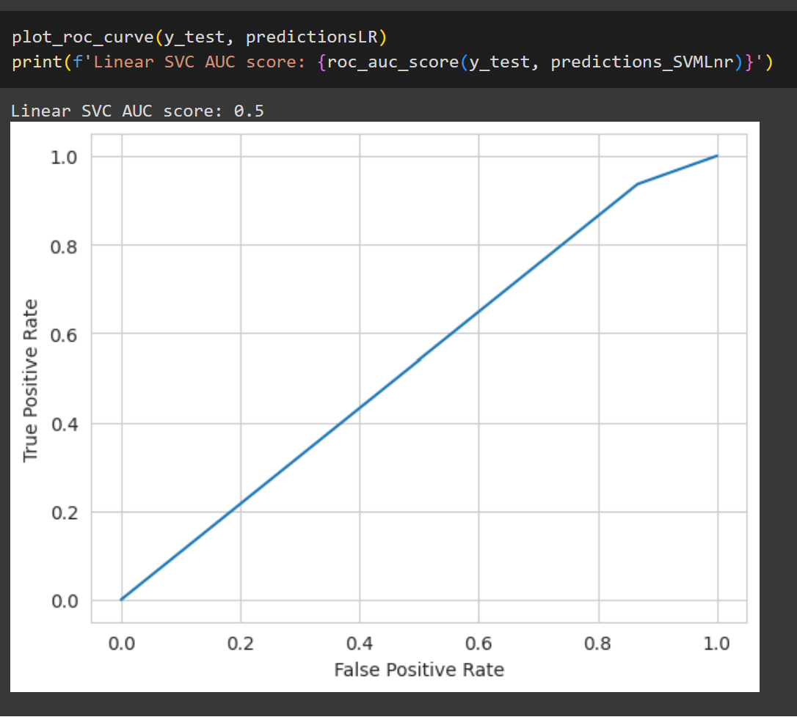

Slide 10
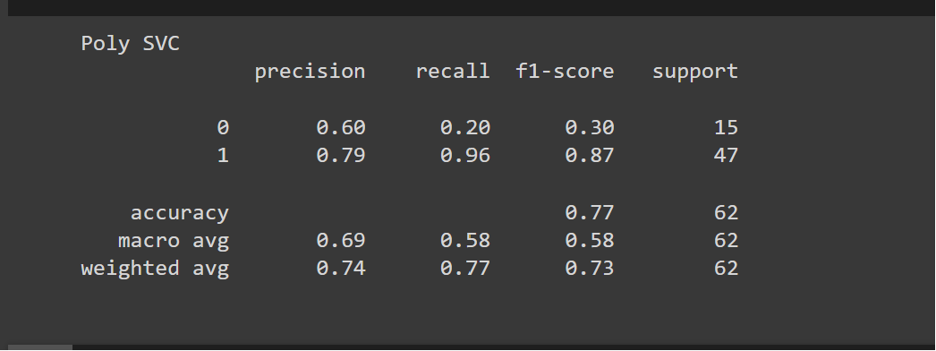
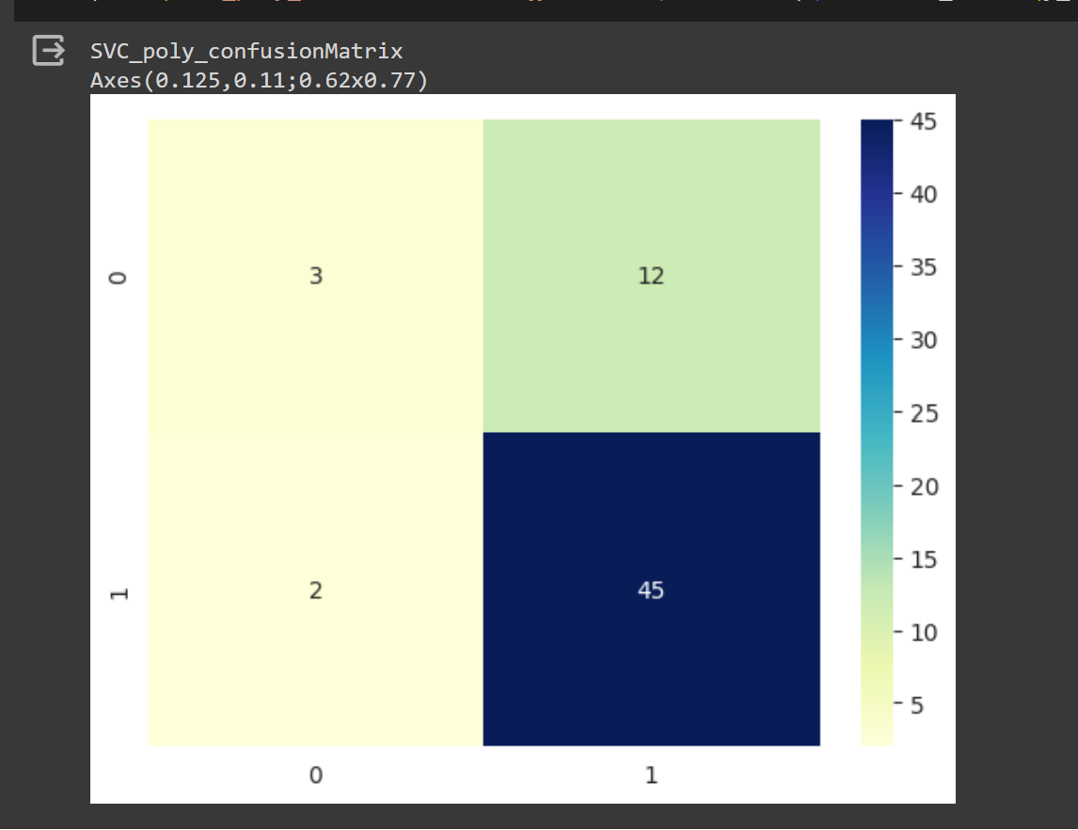
Support Vector Machine
Polynomial SVC

Slide 11
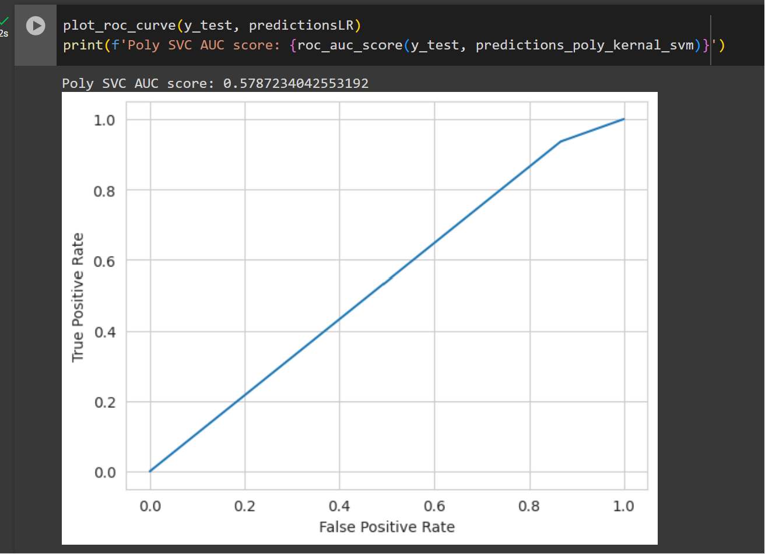

Slide 12
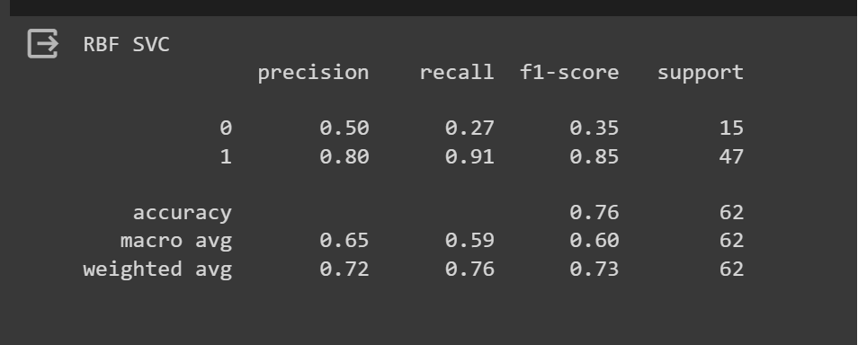
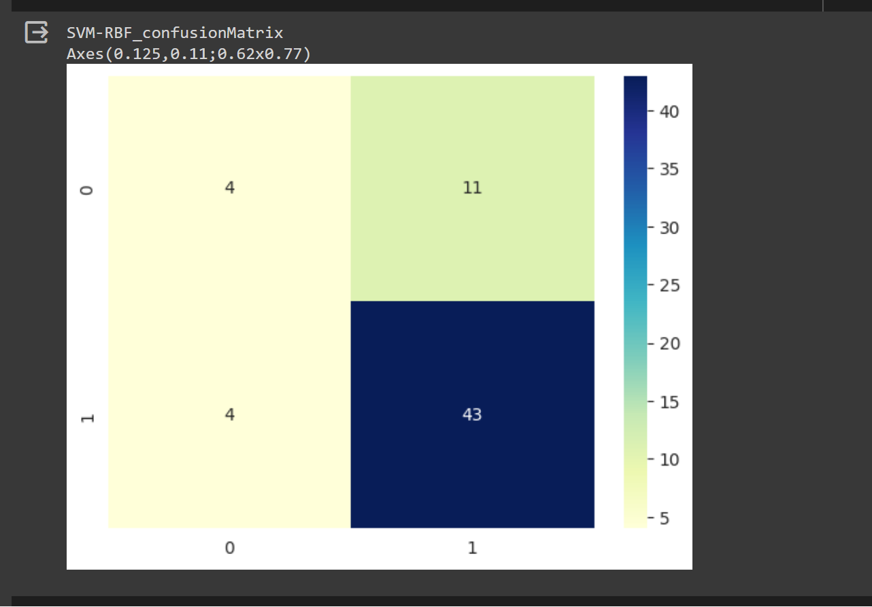
Support Vector Machine
RBF

Slide 13
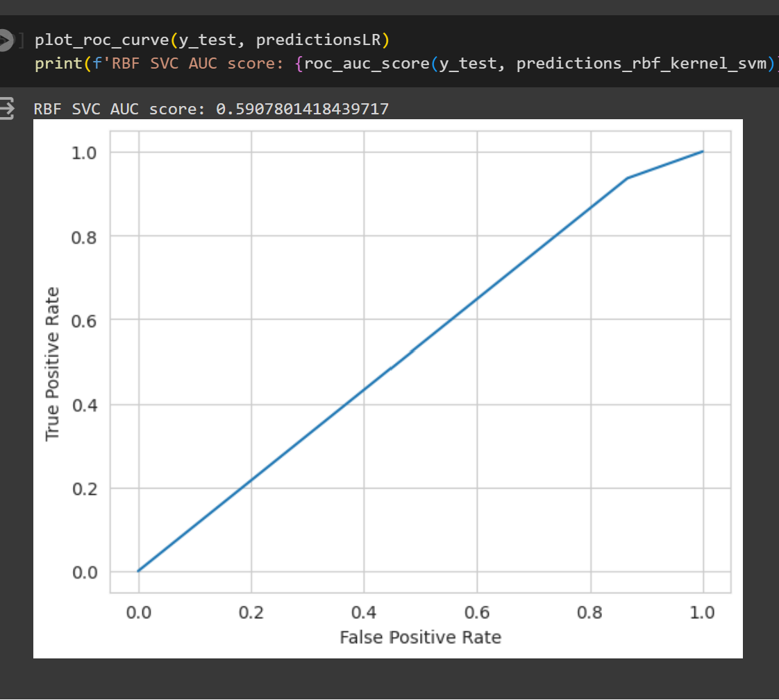

Slide 14
Conclusion:
Based of evaluation criteria: High Accuracy & Recall and AUC >0.5 below models performing good.
Multinomial Naive Bayes
Support Vector Machine (need to explore hyperparameters through tuning using grid search or Randomized Search)

